Slide 1
Predicting Problematic Internet Use
Connor McManus, Sean Shen, Victoria Uchman, Barret White

Slide 2
Introduction
Project Topic
The Problem: Problematic internet use is a growing concern, especially among youth, with impacts on mental health and learning abilities.
The Dataset: We used the Healthy Brain Network (HBN) dataset, containing clinical, physical activity, internet usage, and demographic data for approximately 5,000 participants aged 5–22.
Our Approach
Research Questions:
What drives higher levels of problematic internet use?
Can demographic, physical activity, and behavioral markers predict internet usage severity?
Methodology:
Machine learning models for classification and feature selection.
Evaluation using Quadratic Weighted Kappa (QWK) to balance predictions for ordinal data.
Notes:
Victoria

Slide 3
Dataset Overview
Scope: The HBN dataset contains clinical and research data from approximately 5,000 participants aged 5–22. It integrates information on physical activity, fitness, internet usage behavior, and demographic data to study mental health and learning disorders.
Objective: The dataset aims to identify biological markers for improving the diagnosis and treatment of mental health issues and learning disorders.
Goal: Predict participants' Severity Impairment Index (SII), which measures the degree of problematic internet use (scored from 0 = None to 3 = Severe).
Data Composition:
Tabular Data: Contains participant demographics, physical and fitness measures, and internet usage behavior.
Time-Series Data: Accelerometer readings tracking motion and daily activity.
Notes:
Victoria

Slide 4
Imputation Methods
KNN Imputation
Imputes the mean (or mode, for classification) of the k-nearest neighbors to a missing point
Uses Euclidean distance to measure how close a row with a missing value is (the value of interest) to other rows in the data
We used a value of 5 for K - have to pick arbitrarily
Simple median/mode imputation
We also tried imputing the median (for numerical values) or mode (for categorical) to replace missing values
Only used the column that the missing value occurred in - unlike KNN, this method does not utilize the rest of the data
Notes:
Victoria

Slide 5
MICE (Multivariate Imputation by Chained Equations)
1st iteration: predict missing values of a column using other columns
Other columns temporarily imputed by median and mode
Do this for every column
2nd iteration: predict missing values again with newly imputed data
Better data this time from predictive modeling
Many more iterations
N-th iteration: newly imputed data this iteration is identical to the last iteration
Stabilized results, stop iterating
Strengths:
Robust
Allows for different modeling techniques (Random Forest)
Weaknesses:
Computationally intensive
No guarantee of convergence
Notes:
Sean

Slide 6
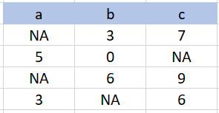
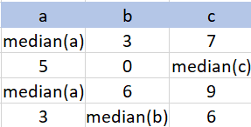
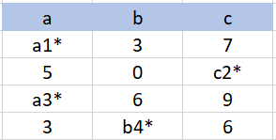
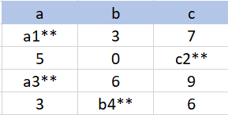
MICE in Pictures
Original data with missing data
Temporary median impute
Impute using imputed (median)
Impute using imputed
(prediction)

Slide 7
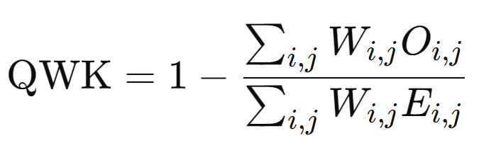
Quadratic Weighted Kappa
QWK is a measure of the agreement between two ordinally scaled samples
This metric varies from 0 (random agreement) to 1 (complete agreement). In the event that there is less agreement than expected by chance, the metric may go below 0.
Assigns weights for different classes, addressing some class imbalance
Notes:
O matrix corresponds to the number of instances that have an actual value, W matrix calculated based on the squared difference between actual and predicted values, E is calculated as the outer product between the actual histogram vector of outcomes and the predicted histogram vector assuming no correlation between values.
and a predicted value
j
.

Slide 8
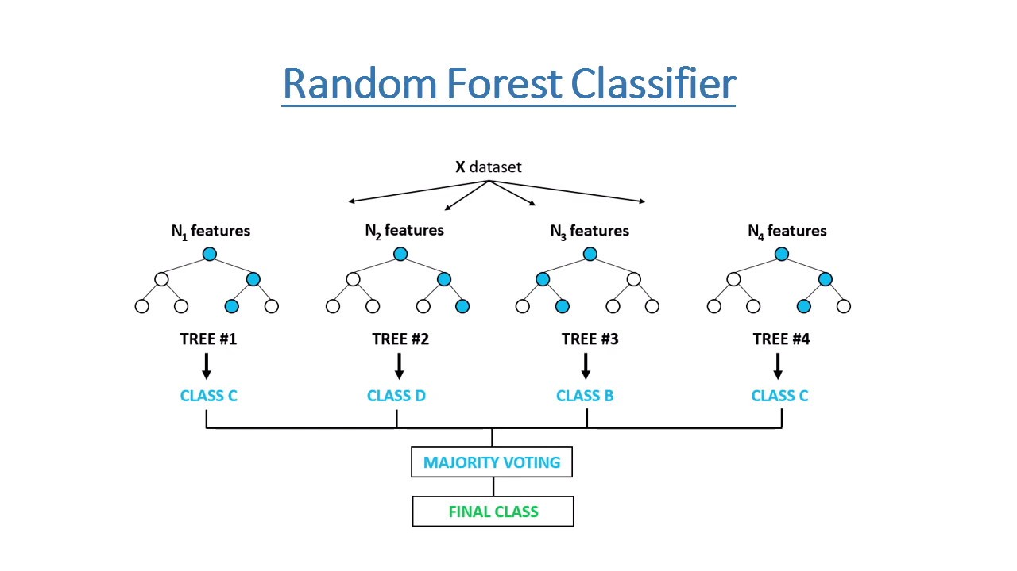
Random Forest
Pros:
Provides feature selection and importance
Can be optimized for QWK
Flexible and performs well in high dimensions
Cons:
Treats ordinal variables as categorical
Can suffer if ordinal classes are imbalanced
Our Random Forest Model obtained a CV 5 fold mean QWK of 0.4204
Notes:
Synthetic Minority Oversampling Technique was used for oversampling to deal with class imbalance

Slide 9
XGBoost
Extension of gradient boosting
Builds upon the pseudo-residuals, rather than the standard residuals, to slowly built a series of sequential trees
Pseudo-residuals: gradients of the loss function with respect to the previous tree’s predictions
Includes information on the direction in which the tree’s predictions need to be adjusted
XGBoost implements regularization (ridge regression, in this case) to control the complexity of the added trees
Primary tuning parameters: number of trees, shrinkage, and depth
Can also tune the minimum loss reduction required to split a tree, how many features are used to build each tree, and the weights of each observation needed to be in a node
Notes:
Connor

Slide 10
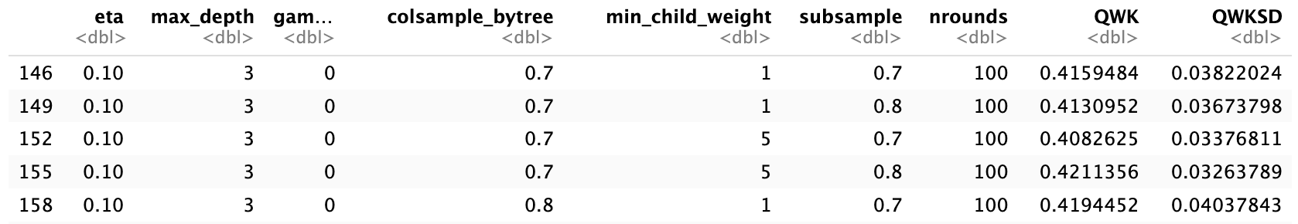
XGBoost Results
Used cross validation to iterate over all possible combinations of parameters
Maximum QWK found at a maximum depth of 3, a shrinkage parameter (eta) of 0.1, and 100 rounds to build the tree
Notes:
Connor

Slide 11
Bidirectional Stepwise QWK
Stepwise framework but with QWK (No AIC, BIC)
polr() for multinomial ordinal regression
Formula, data, method/link function (logistic, probit)
Uses k-fold cv to prevent overfit (QWK does not balance fit and complexity)
Algorithm
Start with no predictors
Add/Remove a predictor, k-fold CV
Improve QWK, then keep the addition/removal
Otherwise, go to the next iteration
Stop when cross-validated QWK does not improve
Notes:
Sean

Slide 12
Stepwise Strengths and Weaknesses
Strengths:
Interpretability of output
Intuitive algorithm
Flexible that added predictors can be removed if not useful later
Weaknesses
Computationally heavy (CV for every change in predictors)
No direct parameter to control model complexity
Potential improvement
Add a penalization term in QWK objective function (like LASSO)
Optimize QWK of a single link function instead of averaging
Using PCA to produce features
Notes:
Sean

Slide 13
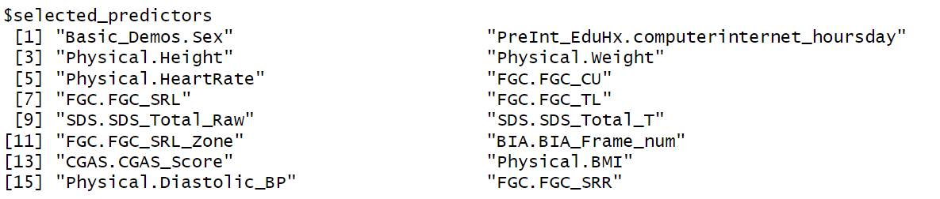
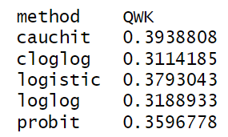
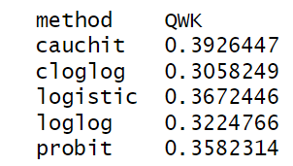
Output - Bidirectional Stepwise QWK
Training cv (5-fold)
Full dataset cv (5-fold)
Notes:
Sean

Slide 14
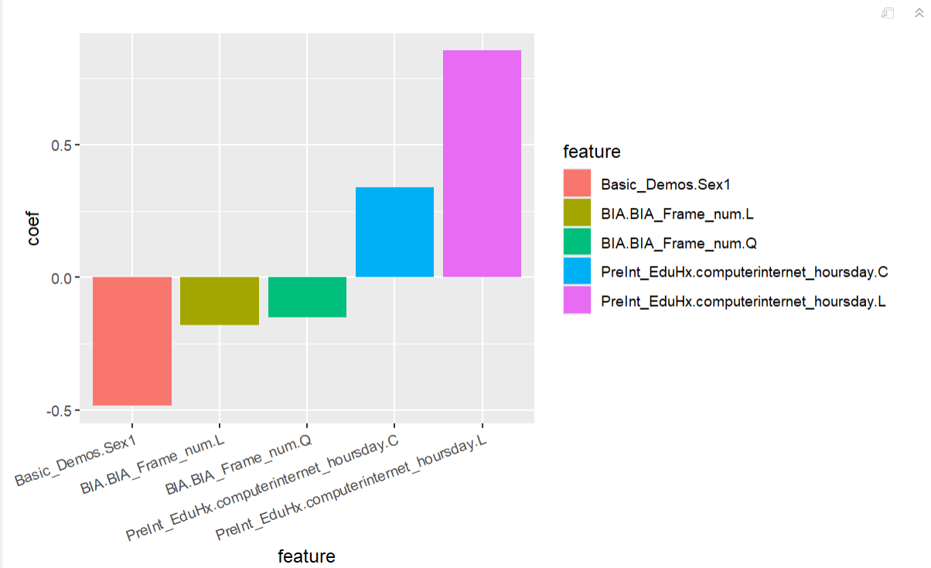
Features with the Highest impact in Stepwise
Notes:
Sean

Slide 15
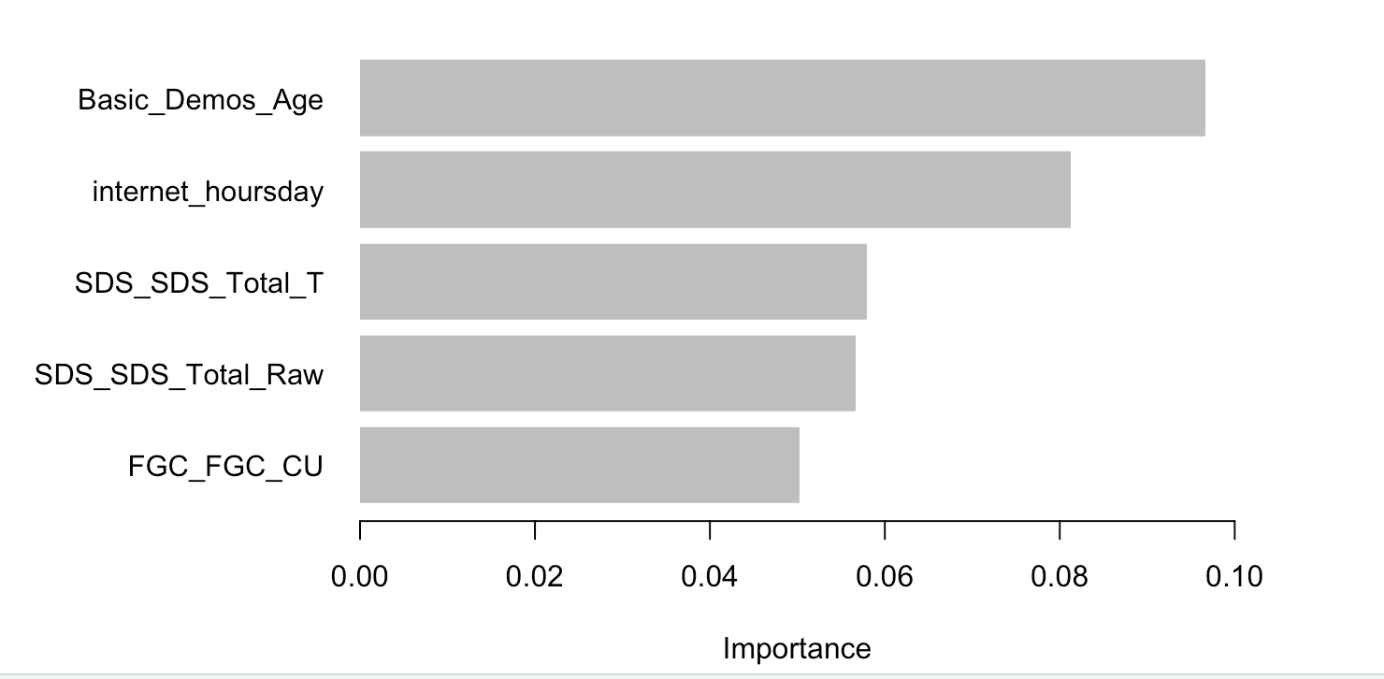
XGBoost Feature Selection
Can perform feature selection: sum the amount each split improves the model performance, weighted by the number of observations in each node
Top 5 factors shown in terms of importance shown below
Notes:
Connor

Slide 16
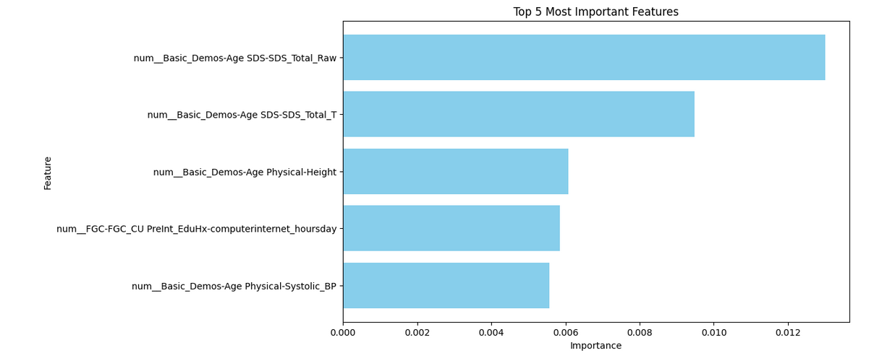
Most Predictive Features
Notes:
Connor

Slide 17
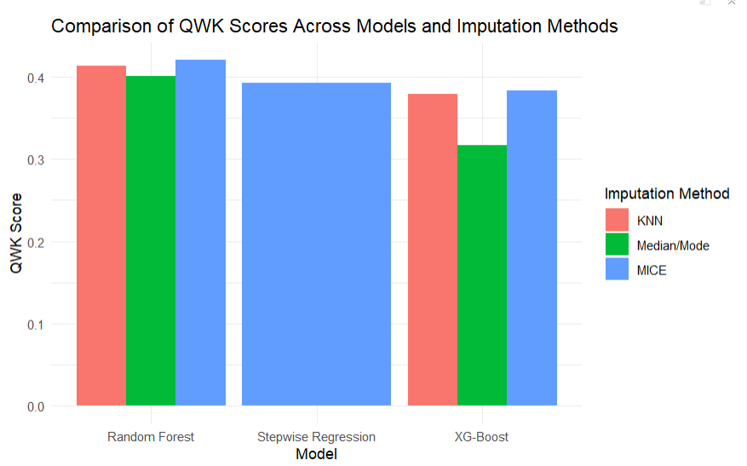
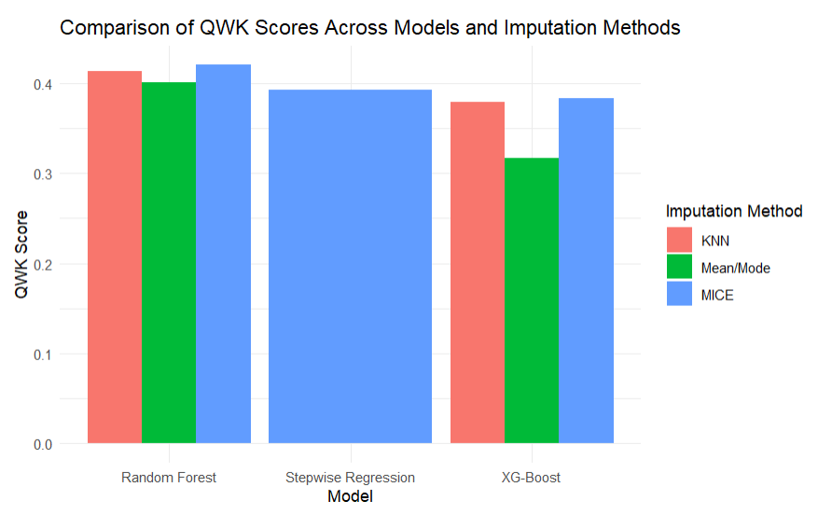
Comparing Models
Notes:
Barrett

Slide 18
Conclusion
Summary of Findings
Top Predictors: Identified key features such as symptom severity scores (SDS raw & standardized), height, daily computer/internet usage, and systolic blood pressure.
Model Performance:
Random Forest: Robust feature selection with a 5-fold CV QWK of 0.420.
XGBoost: QWK with optimized parameters (depth = 3, shrinkage = 0.1).
Bidirectional Stepwise QWK: Provided interpretable insights into ordinal relationships.
Insights Gained:
MICE Imputation: Improved dataset quality, reducing bias from missing values.
Possible Future Directions:
Refining Metric: Penalize terms in QWK for better balancing of fit and complexity
Expanded Analysis: Include time-series data for longitudinal insights
Practical Applications: Inform clinicians and policymakers to tackle problematic internet use
Notes:
Victoria

Slide 19
Bibliography
Child Mind Institute. (n.d.). Child mind institute - problematic internet use. Kaggle.
https://www.kaggle.com/competitions/child-mind-institute-problematic-internet-use/data
“What Is Xgboost? An Introduction to XGBoost Algorithm in Machine Learning: Simplilearn.” Simplilearn.Com, Simplilearn, 7 Nov. 2023, www.simplilearn.com/what-is-xgboost-algorithm-in-machine-learning-article.
MIT School of Distance Education. “Data Imputation Techniques: Handling Missing Data in Machine Learning.” MIT School of Distance Education Blog, blog.mitsde.com/data-imputation-techniques-handling-missing-data-in-machine-learning/

